Slide 1
AMERICAN UNIVERSITY OF THE MIDDLE EAST
College of Engineering and Technology
PD2 Presentation
Smart Parking Occupancy and Warning Indicator System
Course | EECE 255 - Introduction to Electronic Analysis and Design
Group Number | 7
Student Names | Yousef AlAbdulrazzaq Jamal AlEleawah Salem AlDammaj
Student IDs | 75018 10094770 10092588
Supervisor | Dr. Mohammad Al-Rabayah
Submission Date | 05 05 2026
Academic Year | Spring 2026

Slide 2
Project summary:
What the project aims to achieve
With city population increasing demanding larger and taller residential and commercial buildings, the need for efficient parking management is becoming more challenging. A lack of well-designed parking spaces often leads to congestion and long waiting times, and inefficient space utilization increases costs for developers requiring more land.
This project aims to solve these challenges by designing a smart parking occupancy and warning indicator system using only discrete electronic components. Through the use of analog infrared sensors parking space availability will be displayed via color-coded LEDs, with the addition of a buzzer alarm when a vehicle occupies a spot for longer than the allotted time.
.

Slide 3
Alternative Solutions:
Solution A — Microcontroller-Based (Arduino Uno)
❌ ELIMINATED
Uses an Arduino Uno with digital I/O, a software timer (millis()), and NMOS transistor output stages for the LEDs and buzzer. While simple to implement and flexible, this solution is explicitly prohibited by the project constraints — microcontrollers are not permitted at any stage.
Solution B — Fully Discrete (SELECTED ★)
✅ SELECTED — 460 / 500
UA741 op-amp Schmitt trigger (U3) + NPN BJT T10 for sensor buffering and Green LED drive + RC timer (R=100kΩ, C=100µF, τ=10s) + discrete CMOS AND gate (T1, T2, T11, T12) + N-MOSFET driver T13. Fully compliant with all five engineering requirements.
Solution C — 555 Timer IC-Based
⚠ Not selected — 410 / 500
Uses a 555 timer in monostable mode triggered by the comparator output, with NPN BJT drivers for LEDs and buzzer. Technically viable and simpler to time precisely, but relies on a dedicated timer IC rather than a fundamental RC circuit and comparator combination as required.

Slide 4
Decision Matrix:
Criterion / Weight | Sol. A — Arduino | Score A | Sol. B — Fully Discrete ★ | Score B | Sol. C — 555 Timer | Score C
Performance (30%) | 0 × 30 | 0 | 5 × 30 | 150 | 3 × 30 | 90
Cost (25%) | 2 × 25 | 75 | 5 × 25 | 125 | 5 × 25 | 125
Safety (15%) | 3 × 15 | 45 | 5 × 15 | 75 | 5 × 15 | 75
Complexity (20%) | 5 × 20 | 100 | 3 × 20 | 60 | 4 × 20 | 80
Environmental (10%) | 2 × 10 | 20 | 5 × 10 | 50 | 4 × 10 | 40
TOTAL SCORE |  | 240 |  | 460 ★ |  | 410
★ Solution B selected — highest score (460/500) and fully compliant with all project constraints.

Slide 5
System Explanation — Input, Processing & Output:
INPUT — Sensor Stage
An analog IR sensor mounted at each parking bay. When no vehicle is present the sensor output is HIGH (~9V). When a vehicle is detected the output drops LOW (~0V). A voltage divider (R3=10kΩ) conditions the signal before passing it to the processing stage.
PROCESSING — Signal Conditioning & Logic
① NPN BJT T10 (R16=R17=1kΩ) inverts the sensor signal and drives the Green LED.
② UA741 Schmitt Trigger (Vref=1.184V, hysteresis ΔV=15mV) converts the analog signal to a clean digital HIGH/LOW.
③ RC Timer (R=100kΩ, C=100µF, τ=10s) measures occupancy duration — its output goes HIGH once Vcap reaches 5.67V.
④ CMOS AND Gate (T1, T2, T11, T12) combines the Schmitt trigger output and the RC timer output.
OUTPUT — Indicators
Green LED ON → space is free (comparator LOW, BJT T10 saturated).
Red LED ON → vehicle detected (comparator HIGH, MOSFET driver active, IRED=7mA).
Buzzer ON → vehicle overstay > 10s (AND gate output HIGH, N-MOSFET T13 switches buzzer). A flyback diode (1N4148) protects T13 from inductive kickback.

Slide 6
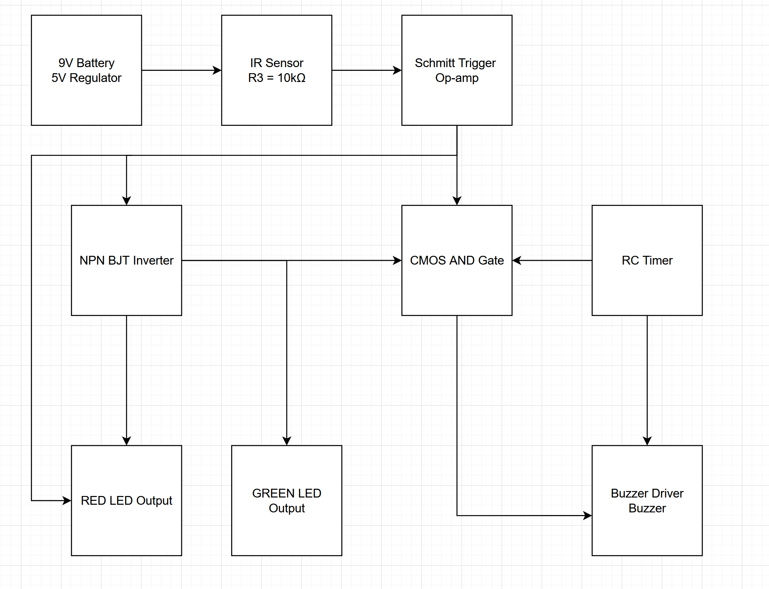
Block Diagram of the System:

Slide 7
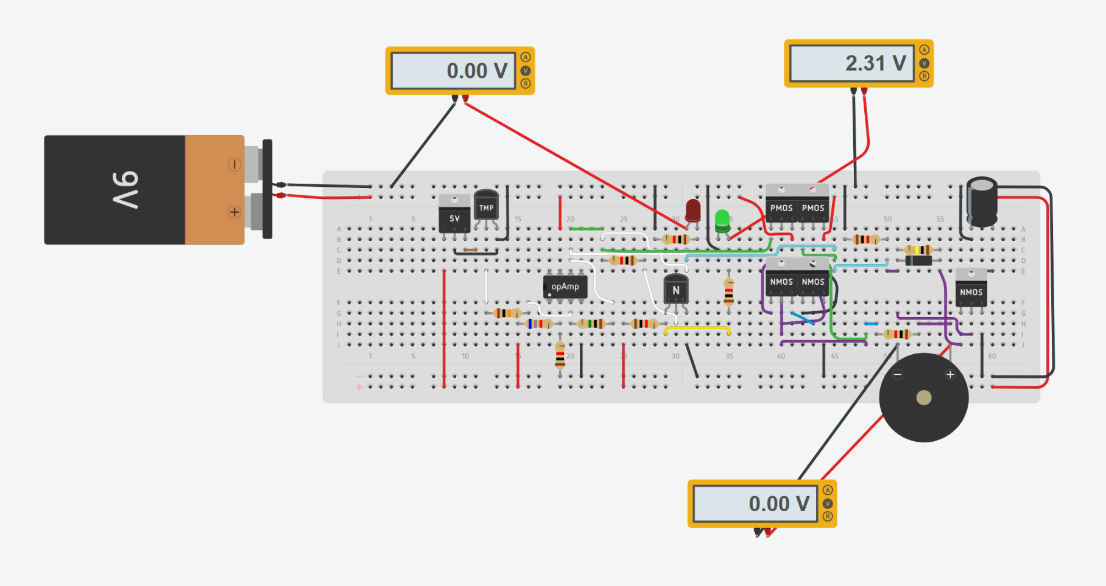
Simulation Results — TinkerCad:
Test Case 1 — No Vehicle Detected
Result: Green LED: 2.31V (ON) | Red LED: 0V (OFF) | Buzzer: 0V (OFF)
Comparator output LOW → RC timer not charging → AND gate output LOW → Buzzer OFF. Green LED driven HIGH through T10.

Slide 8
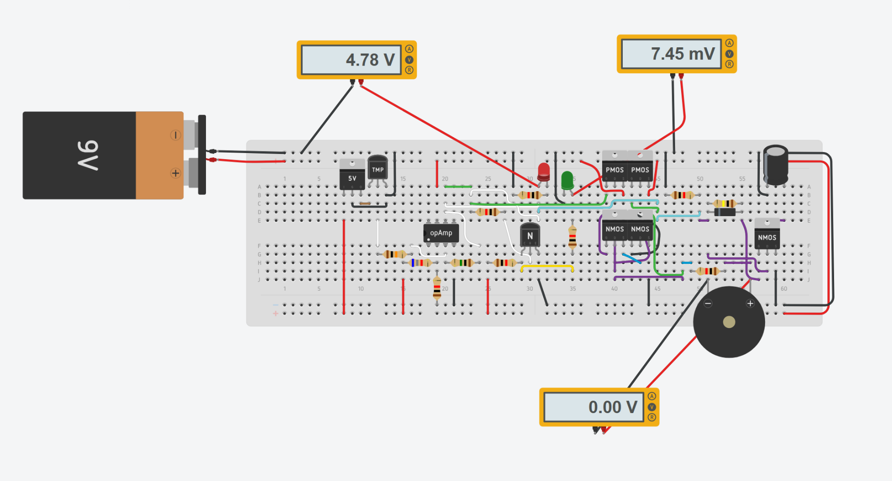
Simulation Results (2) — TinkerCad:
Test Case 2 — Vehicle Detected, Within Time Limit (< 10s)
Result: Red LED: 7.46V (ON) | Green LED: 7.27mV (OFF) | Buzzer: 0V (OFF)
Comparator HIGH → Red LED ON. RC capacitor still charging → timer output LOW → AND gate stays LOW → Buzzer OFF.

Slide 9

Simulation Results (3) — TinkerCad:
Test Case 3 — Vehicle Detected, Overstay (> 10s)
Result: Red LED: 7.46V (ON) | Green LED: OFF | Buzzer: 2.01V (ON, audible)
After 10s: Vcap=5.67V → timer HIGH. AND gate: both inputs HIGH → output HIGH → T13 ON → Buzzer activated. Matches truth table row 4.

Slide 10
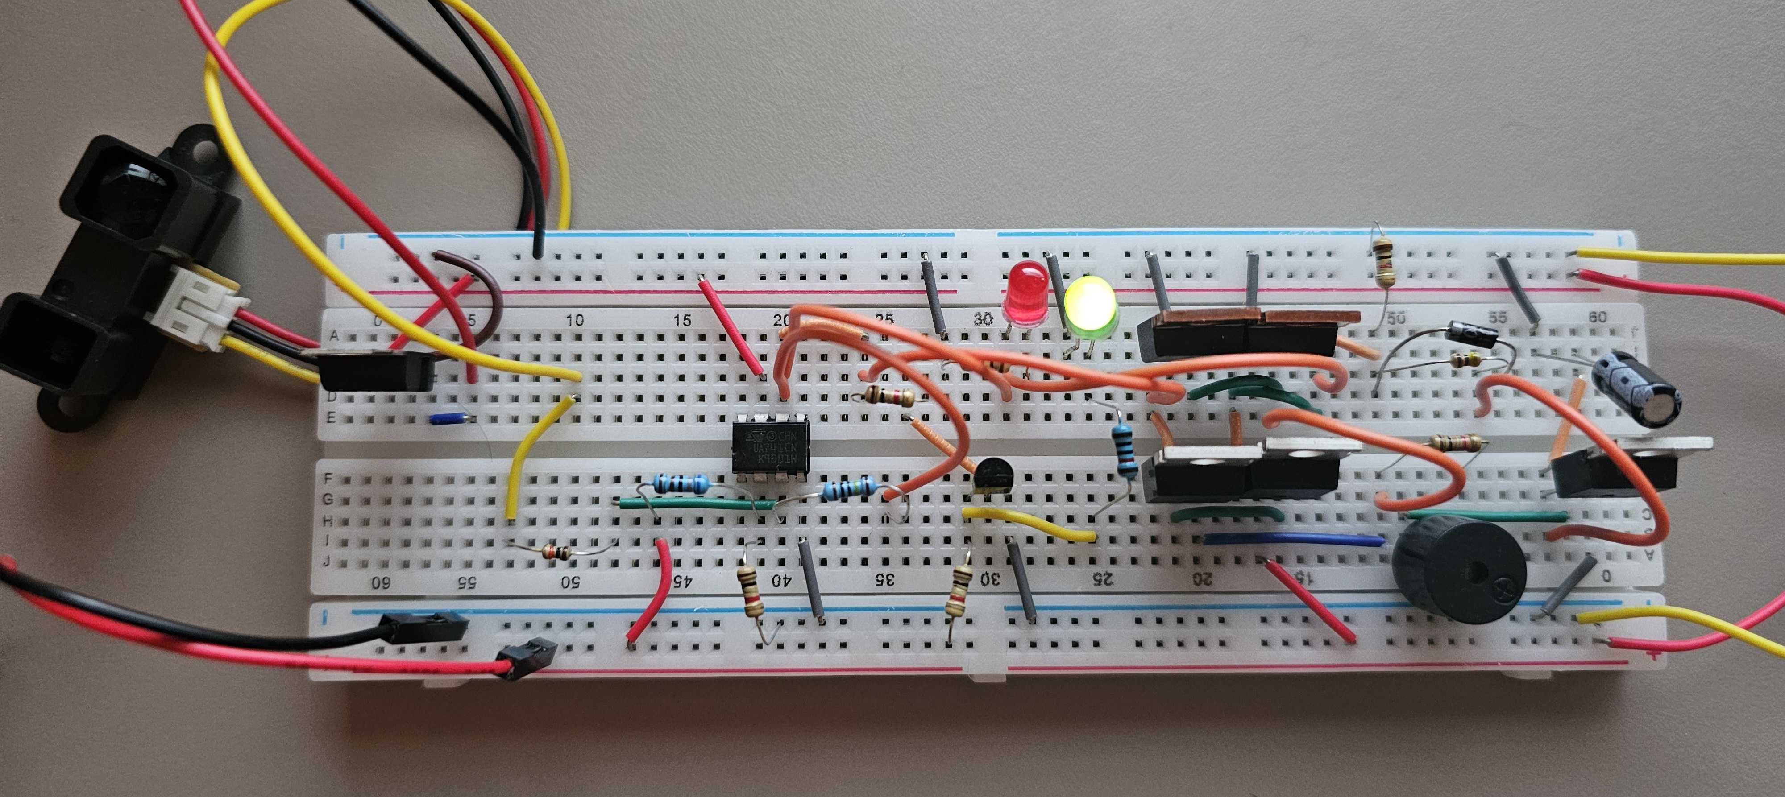
Circuit Photo:

Slide 11
Summary & Outcomes:
Design Process
Six functional blocks were identified and designed independently: 9V power supply + 5V regulator, NPN BJT inverter, UA741 Schmitt trigger (Vref=1.184V, ΔV=15mV), RC timer (τ=10s), discrete CMOS AND gate, and N-MOSFET output driver. All blocks were designed using a block methodology and validated individually.
Decision Outcome
Three solutions were evaluated. Solution B (fully discrete) was selected with a weighted score of 460/500 — the highest. Solution A (Arduino, 240/500) was disqualified for using a microcontroller. Solution C (555 Timer, 410/500) was viable but relied on a dedicated timer IC rather than a fundamental RC circuit.
Verification
All five engineering requirements were met. Three TinkerCad simulation test cases confirmed correct operation: Green LED ON (no vehicle), Red LED ON (vehicle ≤10s), and Buzzer + Red LED ON (vehicle >10s, Vcap=5.67V).
Future work
Change the RC timer circuit to 1 hour instead of 10 seconds and connect the circuit with a display to show the total number of free parking spots.

